Slide 1
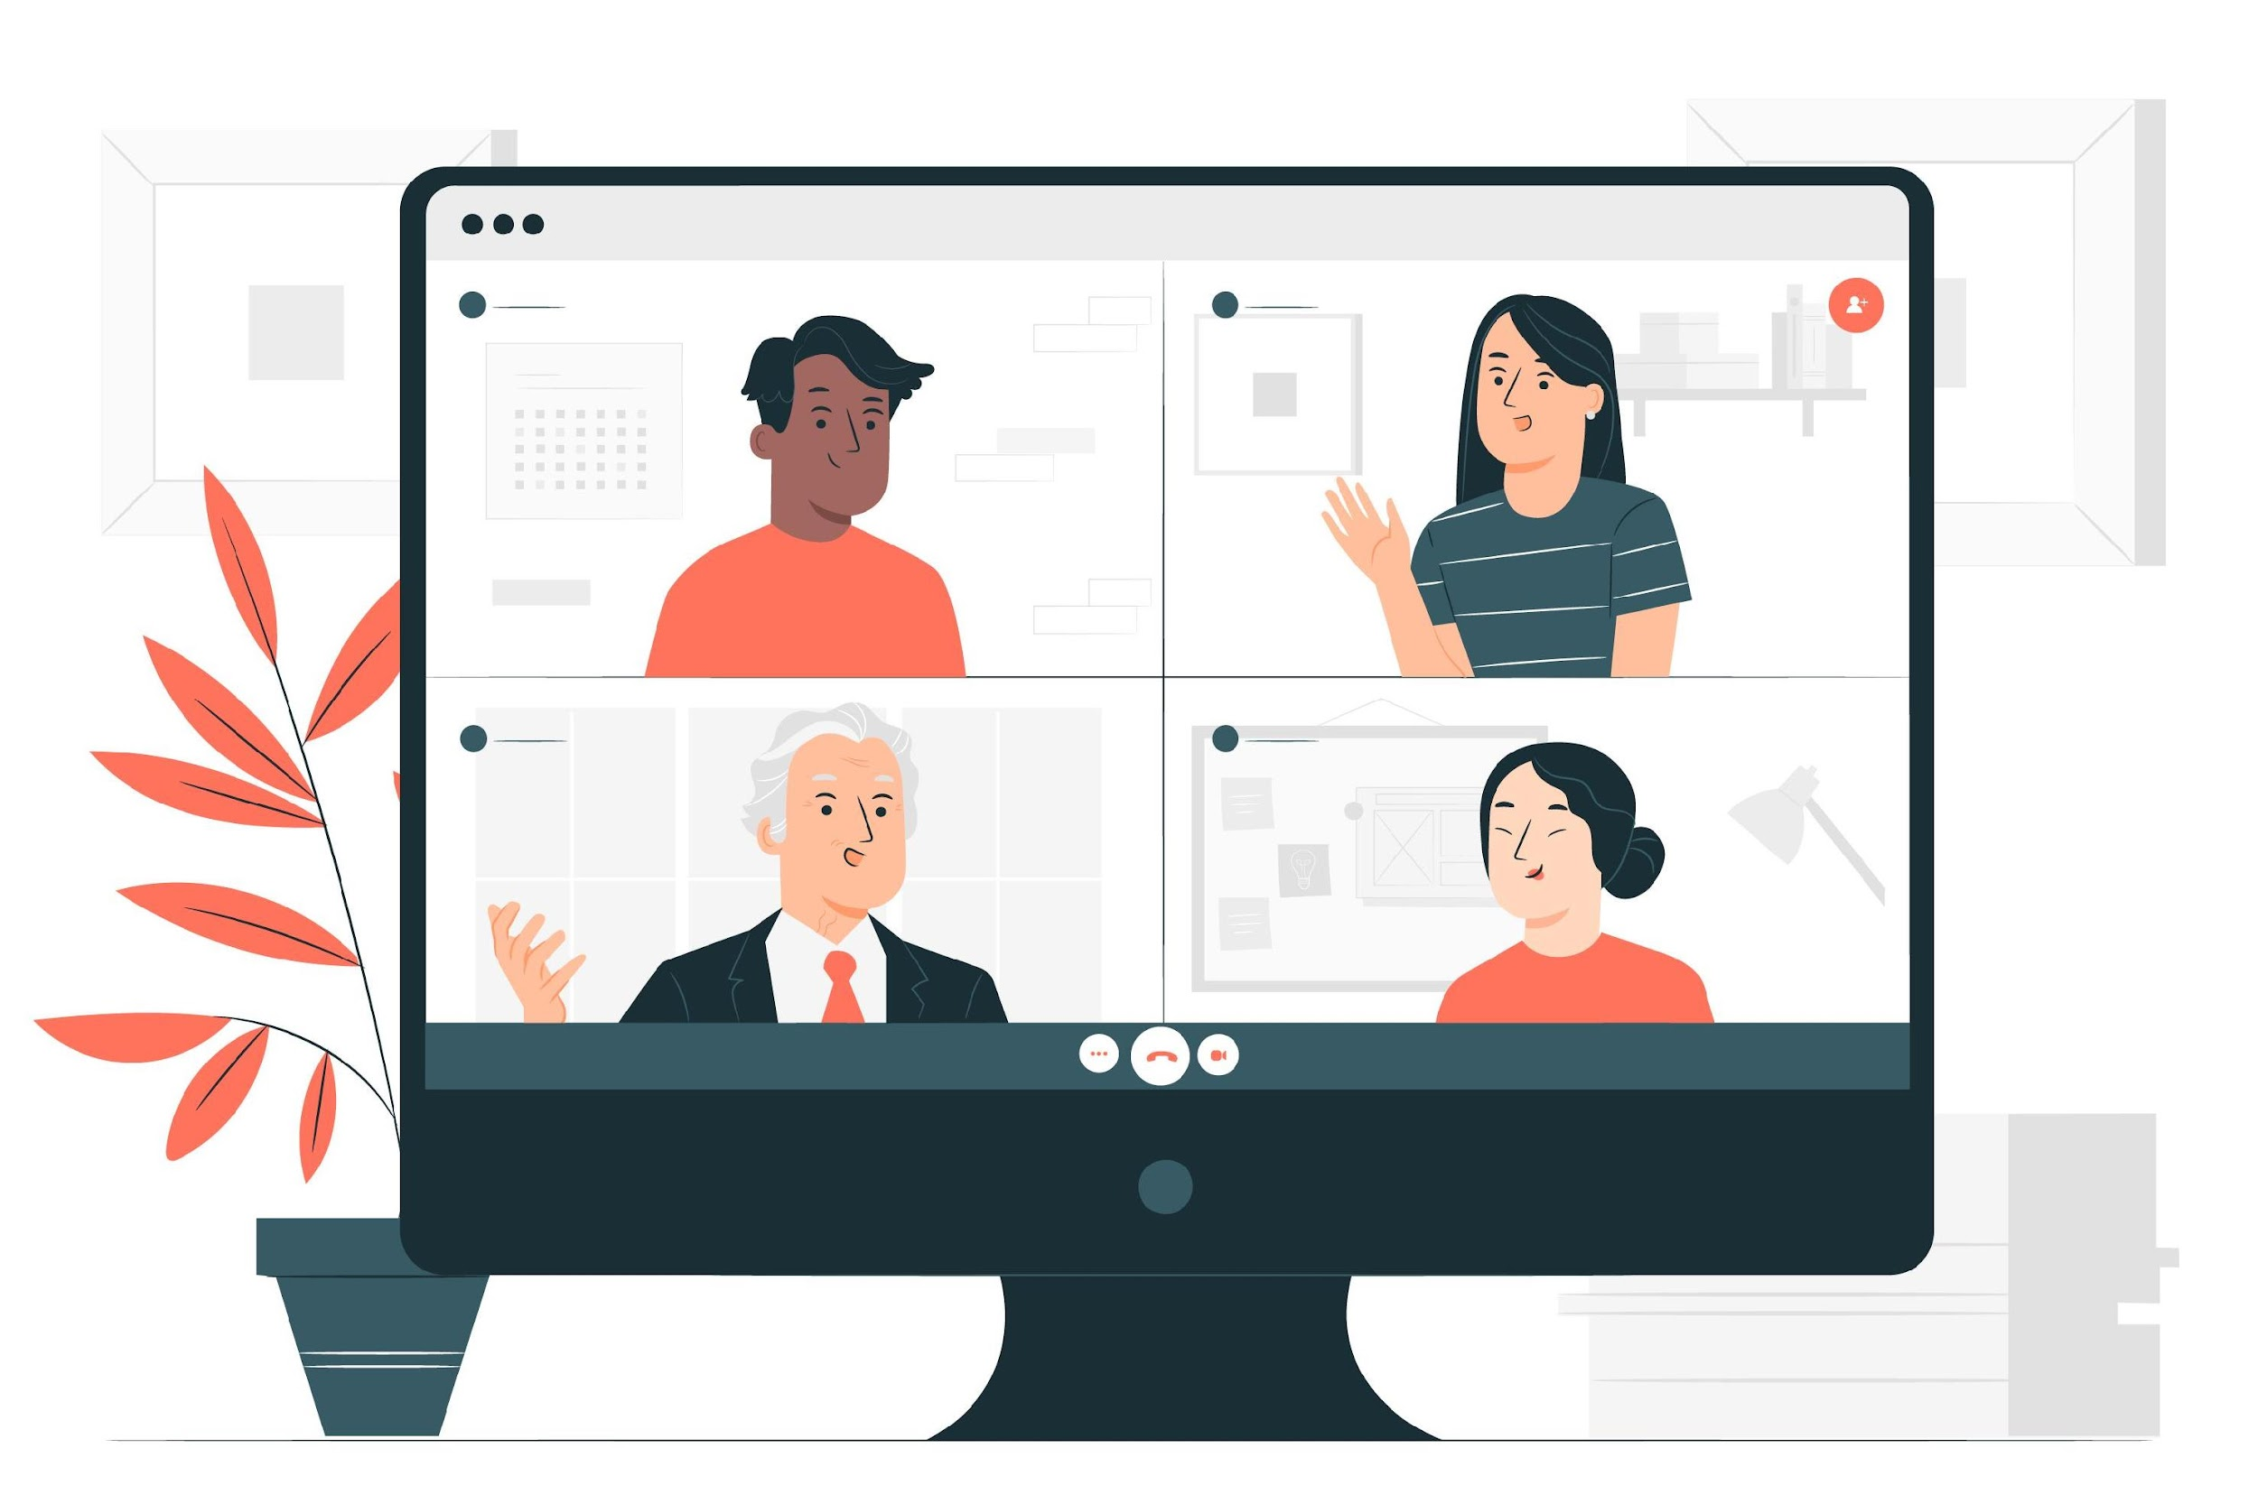
MeetYOU A Cloud Based Meeting Application
Shawon Barman (18201043)
Ferdous Alam Nayeem (18201035)
Jasmine Akter (18201044)
Sanjida Shifa (17101101)

Slide 2
OUTLINE
Functional Requirements
Project Features
Hardware Requirement
Software Requirement
Block Diagram
UML Class Diagram

Slide 3
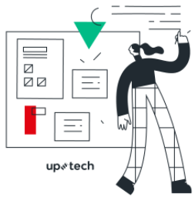
Functional Requirements
Users will be able to converse with another user through voice, video, or text commands.
Host need to be signin in our system to create a video meeting.
Controls for meeting hosts.
Anyone inside or outside your organization can join with a link.
Messaging with participants.
Users need to Gmail account to join the meeting link.

Slide 4
Project features
More than 100 users can join meeting at a time
Hosts can create the meeting link and share another users
Hosts can add user in meeting
Hosts can record the whole session
Hosts can share screen with participants and participants also can share screen
Users can join meeting using just gmail
Participants can communicate with each other through voice, video, or text commands

Slide 5
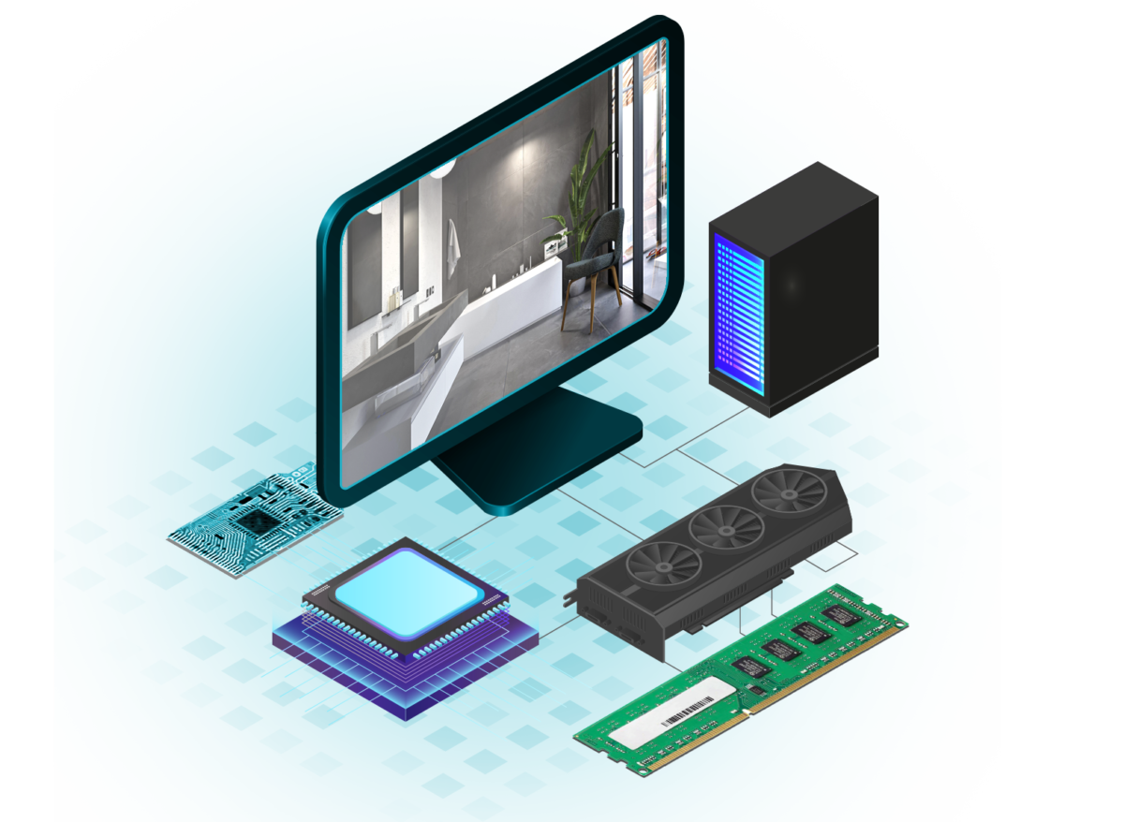
Hardware Requirement
Minimum core i3 processor
Minimum 4gb RAM
Better CPU / GPU

Slide 6

Software Requirement
For Front end:
HTML5
CSS3
Bootstrap 5
Javascript
React
WebRTC
For Back end:
Node.js
Socket.io
For Database:
SQLite
For IDE:
Visual Studio Code

Slide 7
Block Diagram
Join or leave
User
Create meet link
MeetYOU – A cloud based meeting
application
Host
Add user
Video /
Audio
messaging
Meet Link
share
Screen share
record
Database
Notes:
This is the block diagram of our project. Here meetYOU – A cloud based meeting application is our main system. Here host can control the meeting. Host can create a meeting link and then share this meeting another user. Host can add user in meeting. Host can record the whole meeting. User and host can join the meeting and anytime leave from meeting. Participants can send message with each other. User can send meeting link with another user. User and host can share his/her screen. The meeting information are save in our database. Now I called nayeem to talk about the UML diagram.

Slide 8
THANK YOU

